Slide 1
Arduino Functions
The functions allow a programmer to divide a specific code into various sections, and each section performs a particular task. The functions are created to perform a task multiple times in a program.
The function is a type of procedure that returns the area of code from which it is called.
For example, to repeat a task multiple times in code, we can use the same set of statements every time the task is performed.

Slide 2
Advantages of using Functions
Let's discuss some advantages of using functions in programming, which are listed below:
It increases the readability of the code.
It conceives and organizes the program.
It reduces the chances of errors.
It makes the program compact and small.
It avoids the repetition of the set of statements or codes.
It allows us to divide a complex code or program into a simpler one.
The modification becomes easier with the help of functions in a program.
The Arduino has two common functions setup() and loop(), which are called automatically in the background. The code to be executed is written inside the curly braces within these functions. void setup() - It includes the initial part of the code, which is executed only once. It is called as the preparation block.
void loop() - It includes the statements, which are executed repeatedly. It is called the execution block.
But sometimes, we need to write our own functions.

Slide 3
Function Declaration
The method to declare a function is listed below:
Function return type. We need a return type for a function. For example, we can store the return value of a function in a variable. We can use any data type as a return type, such as float, char, etc.
Function name. It consists of a name specified to the function. It represents the real body of the function.
Function parameter. It includes the parameters passed to the function. The parameters
are defined as the special variables, which are used to pass data to a function.
The function must be followed by parentheses ( ) and the semicolon ;
The actual data passed to the function is termed as an argument.

Slide 4
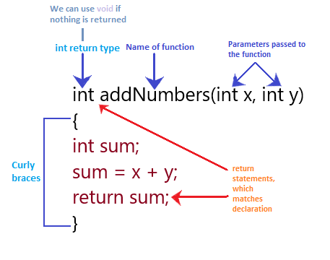
Example 1:
Consider the below image:

Slide 5
Example 2: Here, we will add two numbers.
1. void setup() {
3. Serial.begin(9600);
4. }
void loop() {
int a = 5; // initialization of values to the variables a and b
int b = 4;
int c;
c = myAddfunction(a, b); // c will now contains the value 9
Serial.println(c); // to print the resulted value
delay(1000); // time delay of 1 second or 1000 milliseconds
}
int myAddfunction(int i, int j) {
int sum;
sum = i + j;
return sum

Slide 6
Example 3: Here, we will create a function that determines if a number is even or odd.
Consider the below code.
int a= 0;
int b;
void setup() {
Serial.begin(9600); }
void loop() {
b = Evenfunction(a); // we can store the function return value in variable b
Serial.print(a);
Serial.print(" : "); // to separate even or odd text
if (b==1) {
Serial.println( " Number is even"); }
else {
Serial.println("Number is odd"); }
a++; // the function will increment and will again run
delay(1000); }

Slide 7
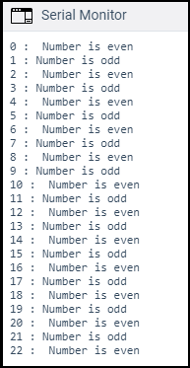
15. int Evenfunction(int d) {
if(d%2==0) {
return 1;
}
else {
return 0;
}
}
Output:
The output is shown below:
and so on...

